Slide 1
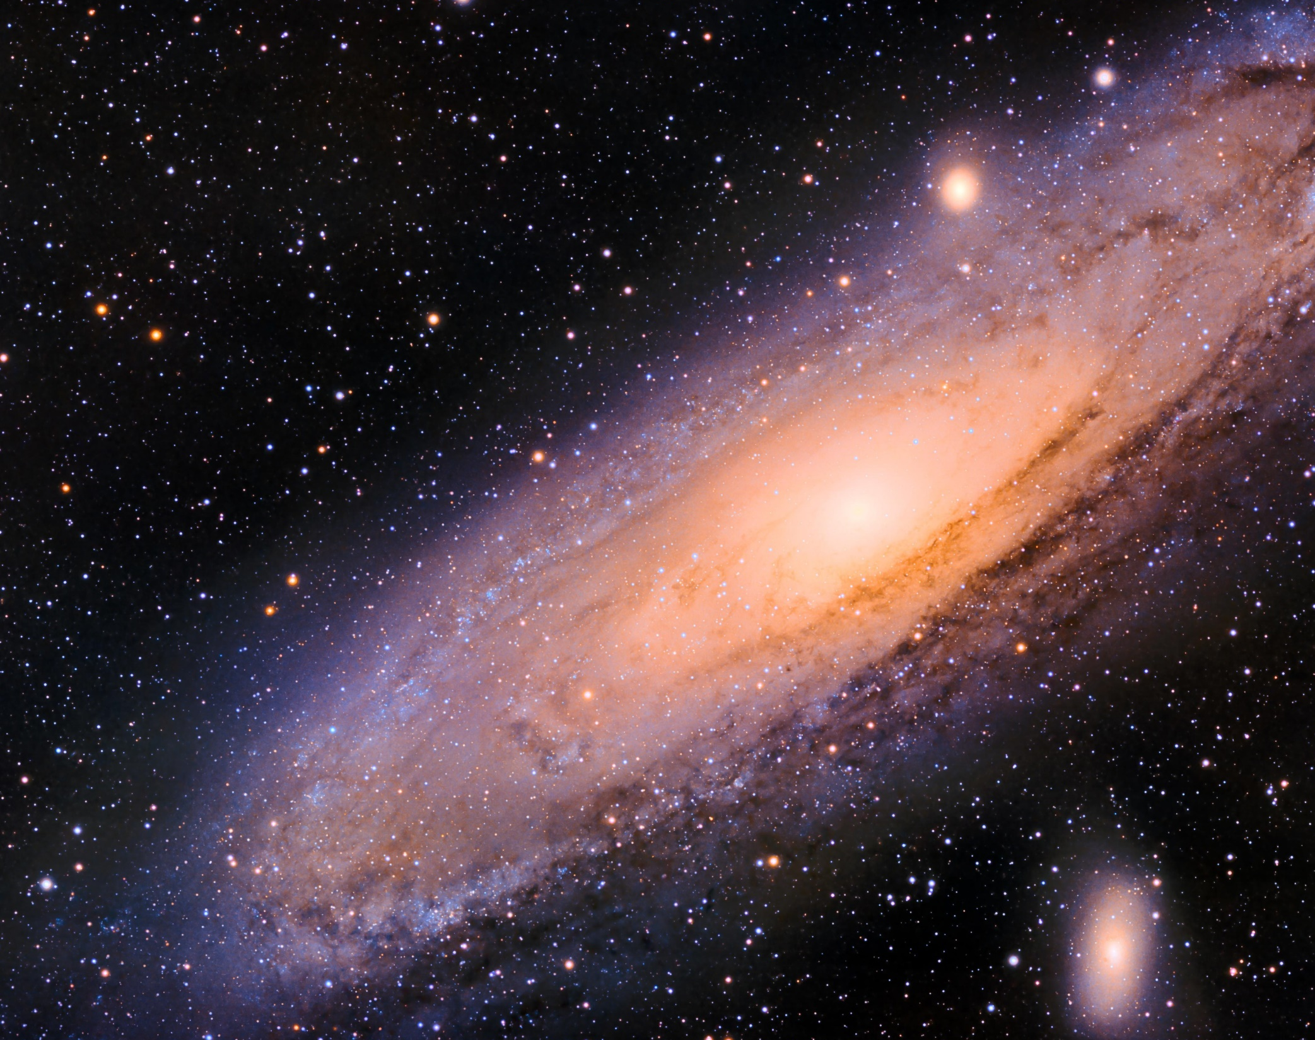
Chaos Theory
Long Term Chaotic Nature of Our Solar System
Done by: Jet Wei

Slide 2
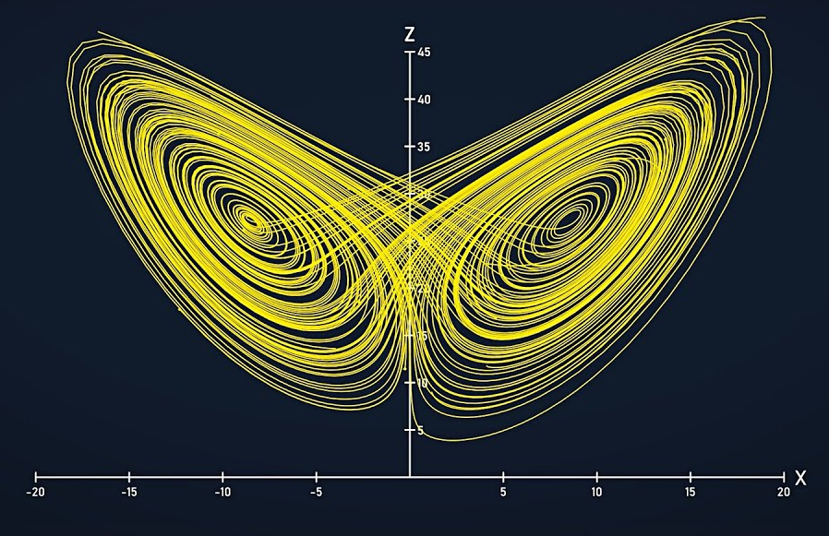
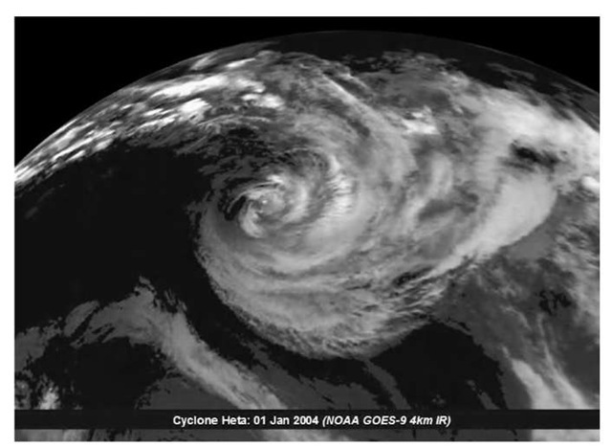
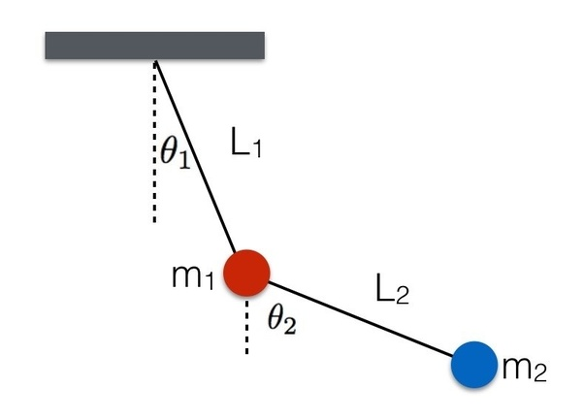
What is Chaos Theory?
From Wikipedia: Chaos theory is an interdisciplinary area of scientific study and branch of mathematics focused on underlying patterns and deterministic laws of dynamical systems that are highly sensitive to initial conditions and were once thought to have completely random states of disorder and irregularities.
The Lorenz Attractor, showing the graph created that somewhat resembles the shape of a butterfly when scientists try to plot the Lorenz system
Other classical examples of non-linear dynamic chaotic systems, the weather and the double pendulum

Slide 3
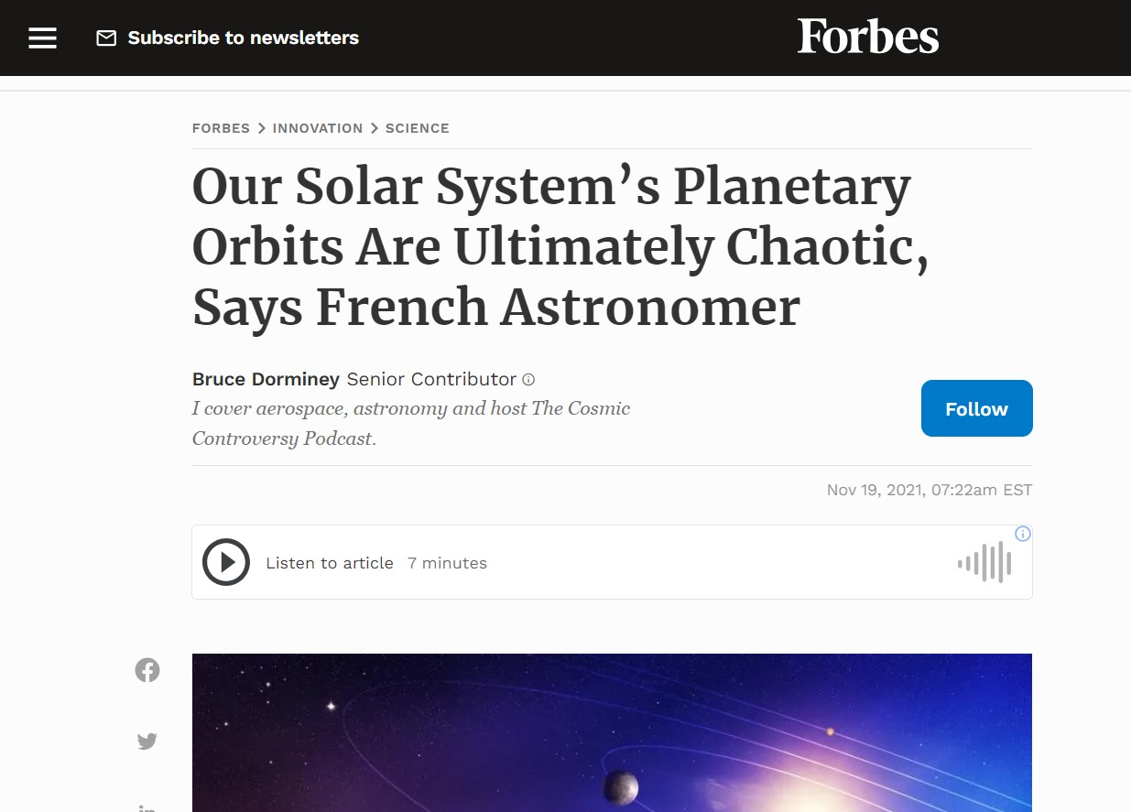
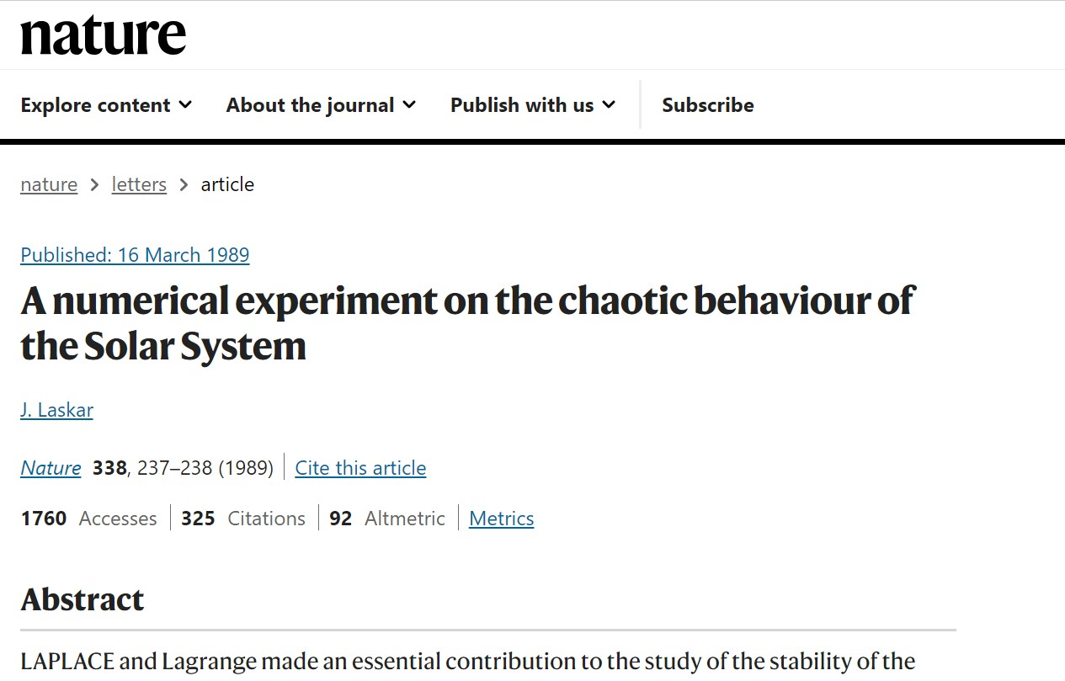
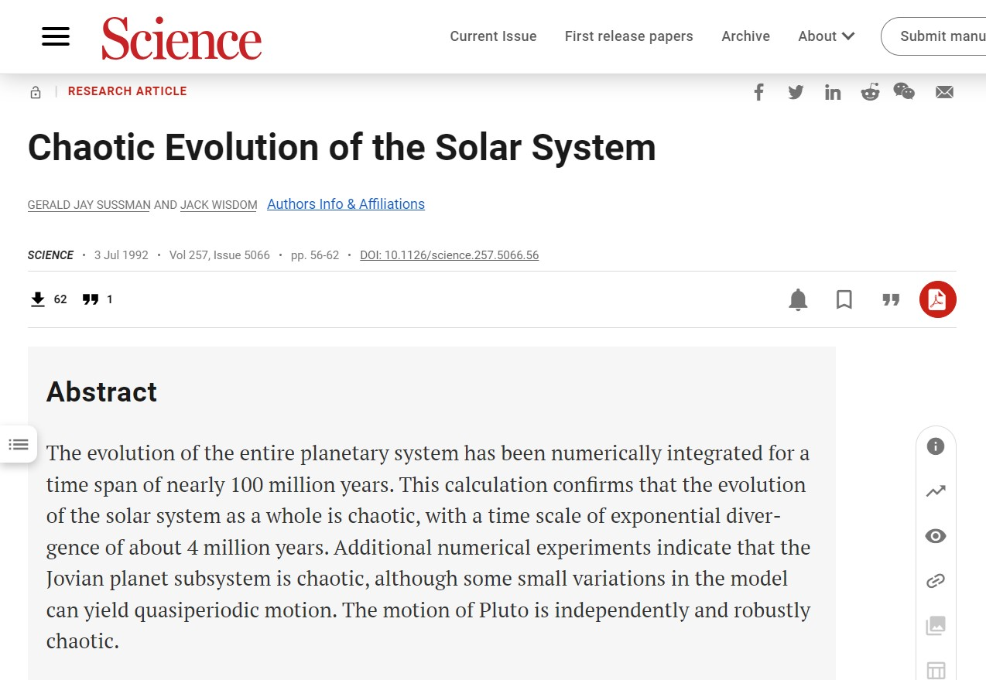
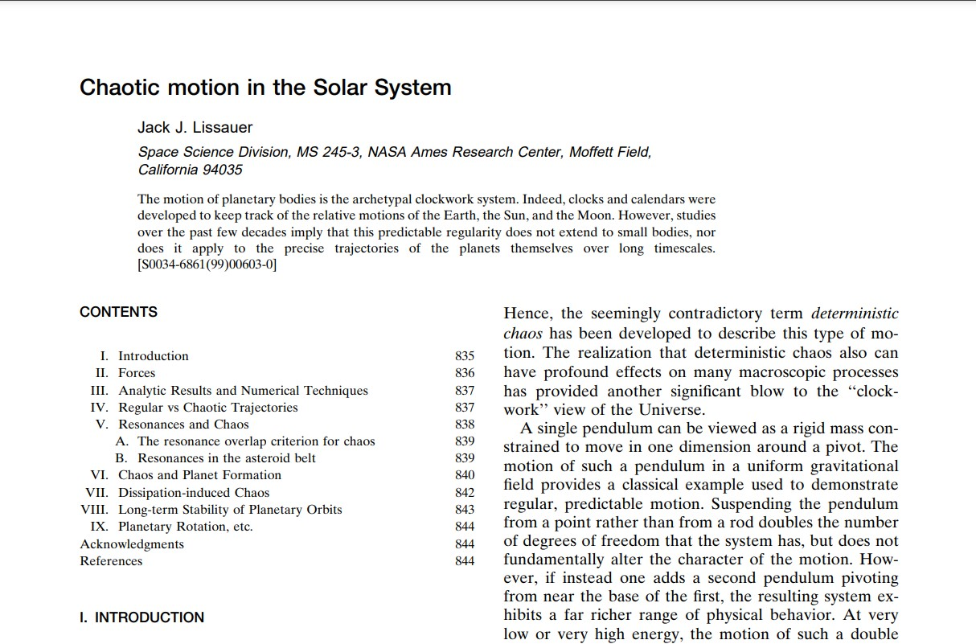
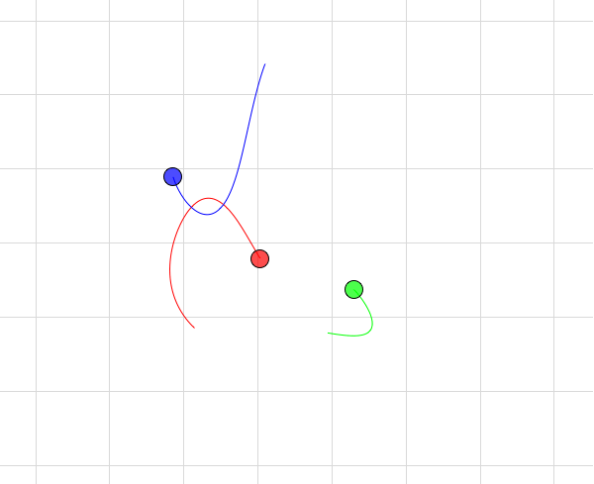
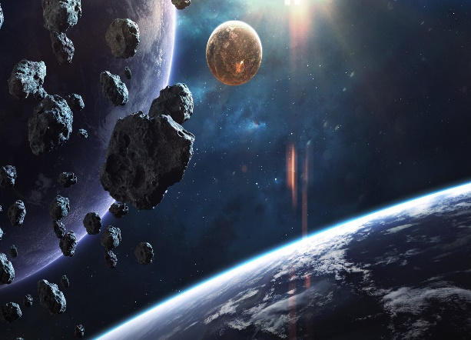
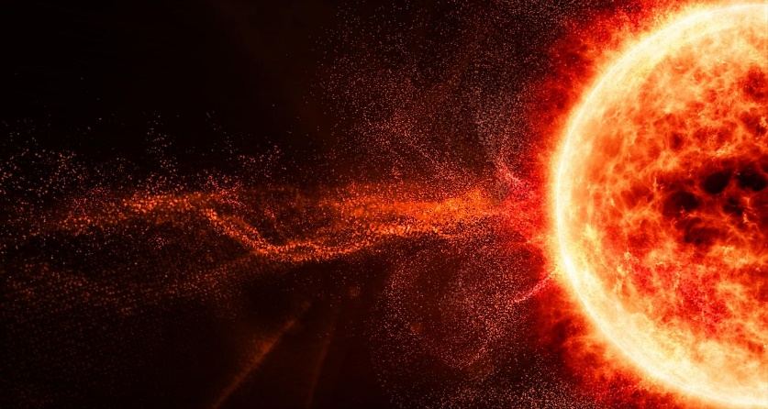
What makes our Solar System chaotic in the long term?
Defining the Solar System: it is the gravitationally bound system of the Sun and the objects that orbit it.
Space is vast, filled with infinitely many physical stuff (asteroids, stars, galaxies) and similarly many phenomena (black holes, supernovas)
While Our Solar System is highly predictable and stable in the short term, in the long term, cumulative eccentricity/orbital chaos in Our Solar System such as,
Effects of the three-body interactions
Mass loss of the Sun
Solar Wind
Asteroids
Passing stars, etc.
can add up, leading to cumulative unpredictable changes to the orbits of planets.
Some possible, but extreme unpredictable behaviour of Our Solar System far, far ahead into the future include Mercury crashing into the Sun, the Earth crashing into Venus, etc.

Slide 4
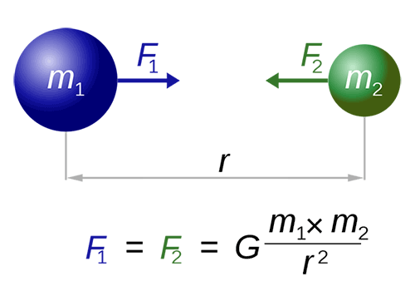
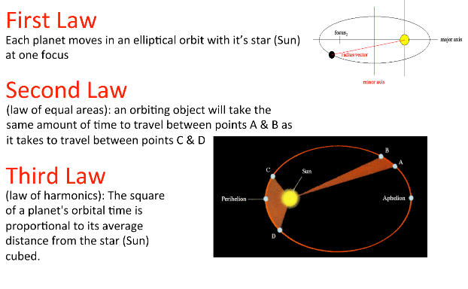
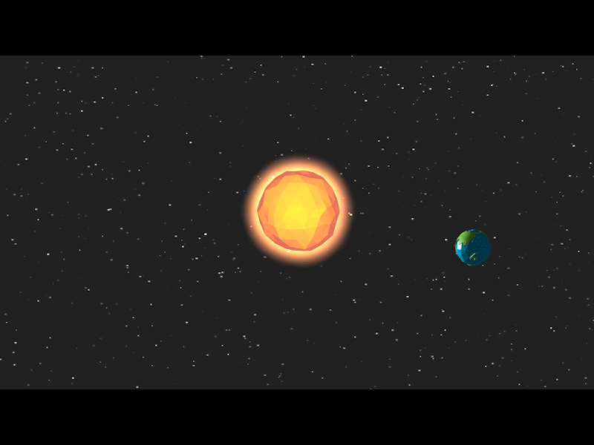
Is Our Solar System chaotic in the short term?
The term ‘short term’, used in this presentation so far actually refers to the short term on the cosmic scale: less than tens of millions of years. However, placing that into human scale, that is still a really, really, really long time, too long for it to even matter.
Hence, the answer to this question is no, Our Solar System is still highly predictable and stable in the short term thanks to mathematical equations and other factors such as,
Newton’s Gravitational Laws
Keplar’s Laws
the massive central mass (the Sun), which makes calculating planetary orbit simpler
isolated nature of Our Solar System (due to the vastness of space)
Hence, fortunately, the Earth is not going to fly out of orbit anytime soon.

Slide 5

Sources
Veritasium Youtube video on 'Chaos: The Science of the Butterfly Effect' (source of inspiration for my choice of our Solar System as my non-linear dynamics chaotic system of interest) (https://www.youtube.com/watch?v=fDek6cYijxI)
ChatGPT (https://chat.openai.com/c/afbd4608-2a55-44c0-9140-00bf288a01e6)
Chaos Theory Wikipedia (https://en.wikipedia.org/wiki/Chaos_theory)
Articles relating to Chaos in our Solar System:
PNAS (https://www.pnas.org/doi/10.1073/pnas.23138409)
Forbes (https://www.forbes.com/sites/brucedorminey/2021/11/19/our-solar-systems-planetary-orbits-are-ultimately-chaotic-says-french-astronomer/?sh=37c269693a35)
Screenshot of the articles relating to Chaos in our Solar System:
https://science.howstuffworks.com/earth-venus-mars-collide.htm
https://www.science.org/doi/abs/10.1126/science.257.5066.56
https://www.nature.com/articles/nphys728
https://harvest.aps.org/v2/journals/articles/10.1103/RevModPhys.71.835/fulltext

